Slide 1
Regression Analysis
Poisson Regression
Nicoleta Serban, Ph.D.
Professor
Stewart School of Industrial and Systems Engineering
Statistical Inference

Slide 2

About This Lesson

Slide 3
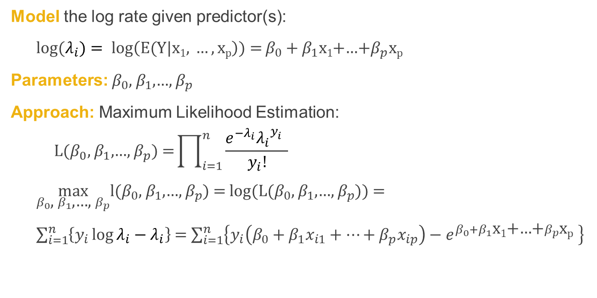
Model Estimation
Model the log rate given predictor(s):
log(${λ_{i})= log\left(E(Y|\text{x}\text{1}\text{, }…,\text{x}\text{p}\right)){=}β}_{0}+β_{1}\text{x}\text{1}$+…+$β_{p}\text{x}\text{p}$
Parameters: $β_{0}$, $β_{1}$,…, $β_{p}$
Approach: Maximum Likelihood Estimation:
$${\text{L}\text{(}β_{0}\text{, }β_{1}\text{,…, }β_{p}\text{)} \text{=}\prod_{i=1}^{n}{\frac{e^{−λ_{i}}{λ_{i}}^{y_{i}^{}}}{y_{i}!}}}$$
$\max_{β_{0}\text{, }β_{1}\text{,…, }β_{p}}$l($β_{0}$, $β_{1}$,…, $β_{p}$) = log(L($β_{0}$, $β_{1}$,…, $β_{p}$)) =
$\sum_{i=1}^{n}{\left\{y_{i}\log{λ_{i}}−λ_{i}\right\}}$ = $\sum_{i=1}^{n}{\left\{y_{i}\left(β_{0}+β_{1}x_{i1}+…+β_{p}x_{ip}\right)−e^{β_{0}+β_{1}\text{x}\text{1}\text{+…+}β_{p}\text{x}\text{p} }\right\}}$

Slide 4

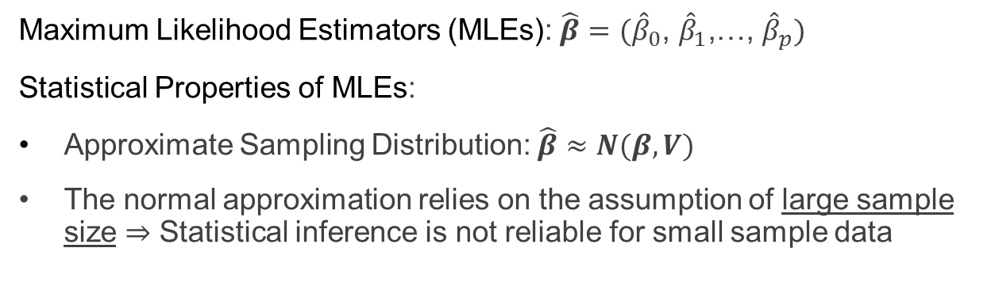
Statistical Inference
Maximum Likelihood Estimators (MLEs): $\hat{β}={(\hat{β}}_{0}\text{, }{\hat{β}}_{1}\text{,…, }{\hat{β}}_{p})$
Statistical Properties of MLEs:
Approximate Sampling Distribution: $\hat{β}≈N(β,V)$
The normal approximation relies on the assumption of large sample size ⇒ Statistical inference is not reliable for small sample data
1-α Approximate
Confidence interval
$\hat{{\text{β}}_{\text{j}}} \text{±} {\text{z}}_{\frac{\text{α}}{\text{2}} }\sqrt{\text{V}\left({\hat{\text{β}}}_{\text{j}}\right)}$

Slide 5
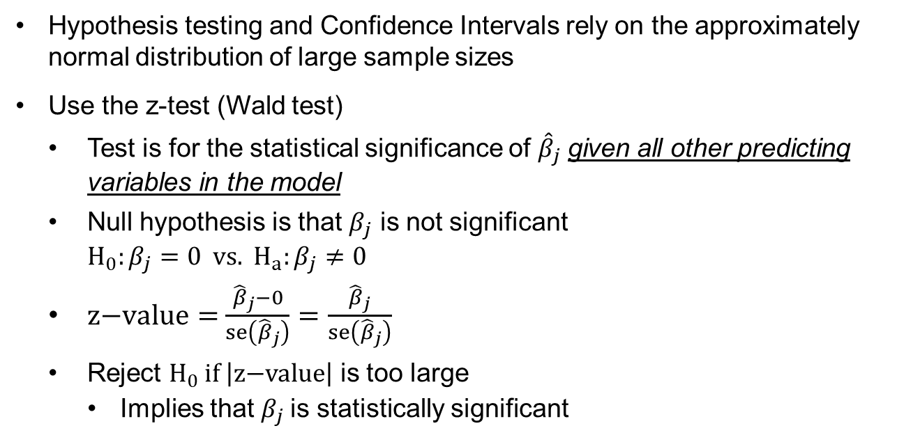
Statistical Inference (cont’d)
Hypothesis testing and Confidence Intervals rely on the approximately normal distribution of large sample sizes
Use the z-test (Wald test)
  Test is for the statistical significance of ${\hat{β}}_{j}$ given all other predicting variables in the model
  Null hypothesis is that $β_{j}$ is not significant
$$H_{0}:β_{j}=0 vs. H_{a}:β_{j}≠0$$
  $z\text{−}value=$ $\frac{{\hat{β}}_{j}−0}{se\left({\hat{β}}_{j}\right)}=\frac{{\hat{β}}_{j}}{se\left({\hat{β}}_{j}\right)}$
  Reject $H_{0}$ if $\left|z\text{−}value\right|$ is too large
    Implies that $β_{j}$ is statistically significant

Slide 6
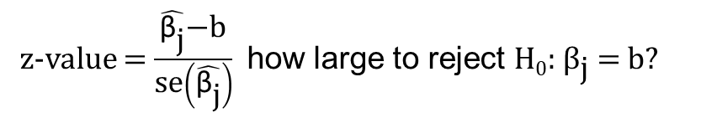
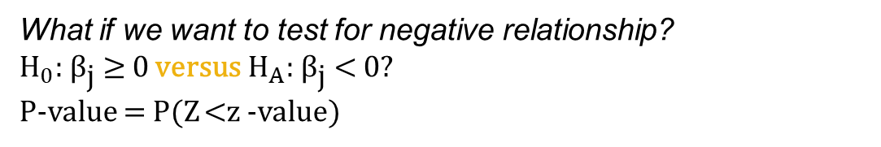

Statistical Inference (cont’d)
z-value = $\frac{\hat{{\text{β}}_{\text{j}}}\text{−}\text{b}}{\text{se}\left(\hat{{\text{β}}_{\text{j}}}\right)}$ how large to reject H₀:${ \text{β}}_{\text{j}}$ = b?
For significance level $α$ , Reject if z-value >${ \text{z}}_{\frac{\text{α}}{\text{2}}}$
Alternatively, compute P-value = 2P(Z >| z-value|)
What if we want to test for positive relationship?
${\text{H}}_{0}\text{:}{ \text{β}}_{\text{j}} \text{≤} \text{0}$ versus ${\text{H}}_{A}\text{:} { \text{β}}_{\text{j}} \text{>} \text{0}\text{?}$
P-value = P(Z >z-value)
What if we want to test for negative relationship?
${\text{H}}_{0}\text{:}{ \text{β}}_{\text{j}} \text{≥} \text{0}$ versus ${\text{H}}_{A}\text{:}{ \text{β}}_{\text{j}} \text{<} \text{0}\text{?}$
P-value = P(Z <z -value)

Slide 7
Statistical Inference (cont’d)
z-value = $\frac{\hat{{\text{β}}_{\text{j}}}\text{−}\text{b}}{\text{se}\left(\hat{{\text{β}}_{\text{j}}}\right)}$ how large to reject H₀:${ \text{β}}_{\text{j}}$ = b?
Because the approximation of the normal distribution relies on large sample size, so do the hypothesis testing procedures.
What if n is small?
The hypothesis testing procedure will have a probability of type I error larger than the significance level.
In other words, there will likely be more type I errors than expected.
For significance level $α$ , Reject if z-value >${ \text{z}}_{\frac{\text{α}}{\text{2}}}$
Alternatively, compute P-value = 2P(Z >| z-value|)
What if we want to test for positive relationship?
${\text{H}}_{0}\text{:}{ \text{β}}_{\text{j}} \text{≤} \text{0}$ versus ${\text{H}}_{A}\text{:} { \text{β}}_{\text{j}} \text{>} \text{0}\text{?}$
P-value = P(Z >z-value)
What if we want to test for negative relationship?
${\text{H}}_{0}\text{:}{ \text{β}}_{\text{j}} \text{≥} \text{0}$ versus ${\text{H}}_{A}\text{:}{ \text{β}}_{\text{j}} \text{<} \text{0}\text{?}$
P-value = P(Z <z -value)

Slide 8
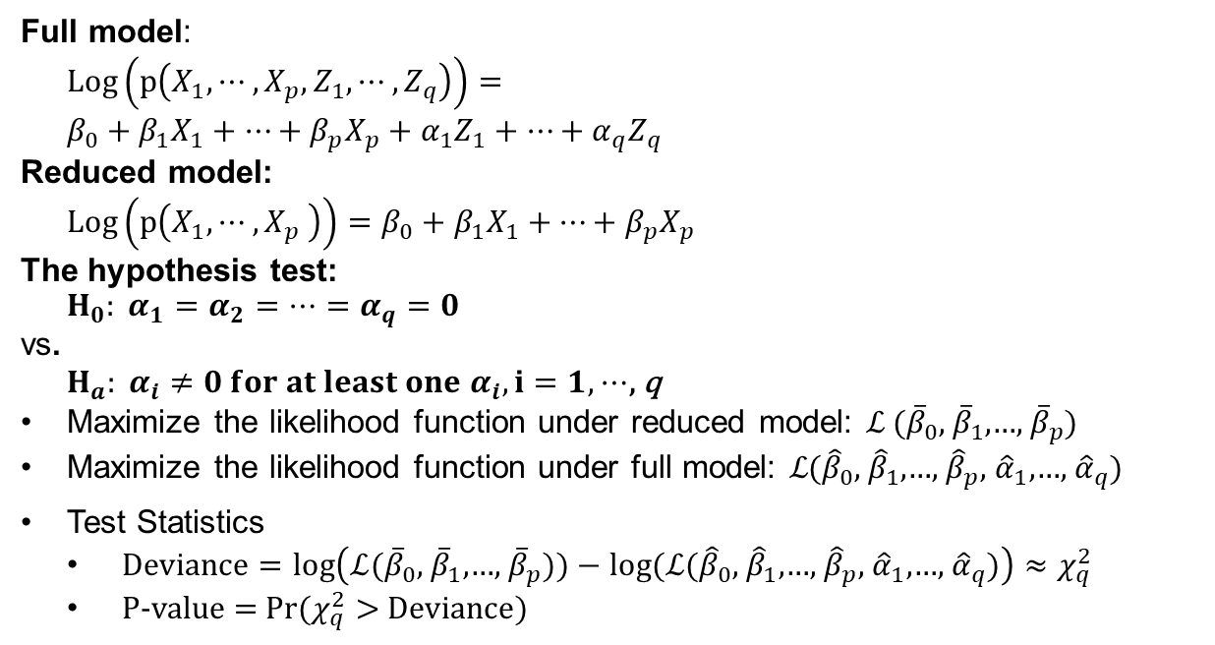
Testing for Subsets of Coefficients
Full model:
$$\text{Log}\left(p\left(X_{1},⋯,X_{p},Z_{1},⋯,Z_{q}\right)\right)=$$
$$β_{0}+β_{1}X_{1}+⋯+β_{p}X_{p}+α_{1}Z_{1}+⋯+α_{q}Z_{q}$$
Reduced model:
$$\text{Log}\left(p\left(X_{1},⋯,X_{p} \right)\right)=β_{0}+β_{1}X_{1}+⋯+β_{p}X_{p}$$
The hypothesis test:
$$H_{0}: α_{1}=α_{2}=⋯=α_{q}=0$$
vs.
$H_{a}: α_{i}≠0 for at least one{ α}_{i}, i=1,$ $⋯$, q
Maximize the likelihood function under reduced model: ℒ ${(\overline{β}}_{0}\text{, }{\overline{β}}_{1}\text{,…, }{\overline{β}}_{p})$
Maximize the likelihood function under full model: ℒ${(\hat{β}}_{0}\text{, }{\hat{β}}_{1}\text{,…, }{\hat{β}}_{p}$, ${\hat{α}}_{1}\text{,…, }{\hat{α}}_{q}$)
Test Statistics
  $Deviance=log\left(\text{ℒ}{(\overline{β}}_{0}\text{, }{\overline{β}}_{1}\text{,…, }{\overline{β}}_{p}))−log(\text{ℒ}{(\hat{β}}_{0}\text{, }{\hat{β}}_{1}\text{,…, }{\hat{β}}_{p}\text{, }{\hat{α}}_{1}\text{,…, }{\hat{α}}_{q}\text{)}\right)≈χ_{q}^{2}$
  P-value = Pr($χ_{q}^{2}>$ $Deviance$)

Slide 9
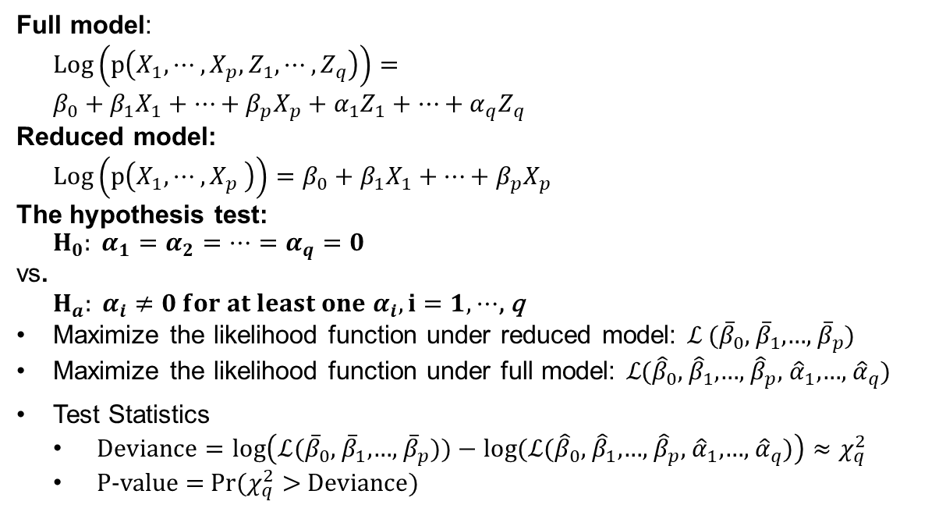
Testing for Subsets of Coefficients
Full model:
$$\text{Log}\left(p\left(X_{1},⋯,X_{p},Z_{1},⋯,Z_{q}\right)\right)=$$
$$β_{0}+β_{1}X_{1}+⋯+β_{p}X_{p}+α_{1}Z_{1}+⋯+α_{q}Z_{q}$$
Reduced model:
$$\text{Log}\left(p\left(X_{1},⋯,X_{p} \right)\right)=β_{0}+β_{1}X_{1}+⋯+β_{p}X_{p}$$
The hypothesis test:
$$H_{0}: α_{1}=α_{2}=⋯=α_{q}=0$$
vs.
$H_{a}: α_{i}≠0 for at least one{ α}_{i}, i=1,$ $⋯$, q
Maximize the likelihood function under reduced model: ℒ ${(\overline{β}}_{0}\text{, }{\overline{β}}_{1}\text{,…, }{\overline{β}}_{p})$
Maximize the likelihood function under full model: ℒ${(\hat{β}}_{0}\text{, }{\hat{β}}_{1}\text{,…, }{\hat{β}}_{p}$, ${\hat{α}}_{1}\text{,…, }{\hat{α}}_{q}$)
Test Statistics
  $Deviance=log\left(\text{ℒ}{(\overline{β}}_{0}\text{, }{\overline{β}}_{1}\text{,…, }{\overline{β}}_{p}))−log(\text{ℒ}{(\hat{β}}_{0}\text{, }{\hat{β}}_{1}\text{,…, }{\hat{β}}_{p}\text{, }{\hat{α}}_{1}\text{,…, }{\hat{α}}_{q}\text{)}\right)≈χ_{q}^{2}$
  P-value = Pr($χ_{q}^{2}>$ $Deviance$)
The hypothesis test for subsets of coefficients is approximate
This is not a test for goodness of fit!
It only compares two models

Slide 10
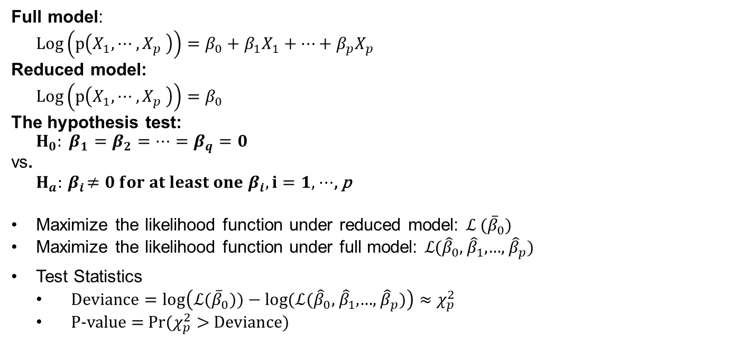
Testing for Overall Regression
Full model:
$$\text{Log}\left(p\left(X_{1},⋯,X_{p} \right)\right)=β_{0}+β_{1}X_{1}+⋯+β_{p}X_{p}$$
Reduced model:
$$\text{Log}\left(p\left(X_{1},⋯,X_{p} \right)\right)=β_{0}$$
The hypothesis test:
$$H_{0}: β_{1}=β_{2}=⋯=β_{q}=0$$
vs.
$H_{a}:{ β}_{i}≠0 for at least one{ β}_{i}, i=1,$ $⋯$, p
Maximize the likelihood function under reduced model: ℒ ${(\overline{β}}_{0})$
Maximize the likelihood function under full model: ℒ${(\hat{β}}_{0}\text{, }{\hat{β}}_{1}\text{,…, }{\hat{β}}_{p}$)
Test Statistics
  $Deviance=log\left(\text{ℒ}{(\overline{β}}_{0}))−log(\text{ℒ}{(\hat{β}}_{0}\text{, }{\hat{β}}_{1}\text{,…, }{\hat{β}}_{p}\text{)}\right)≈χ_{p}^{2}$
  P-value = Pr($χ_{p}^{2}>$ $Deviance$)

Slide 11

Summary

